Slide 1
Project Forecast Placeholder 12 December 2018

Slide 2
1. Executive Summary (1/1)
Project Overview
Objective: To determine if there is a statistically significant relationship between a company’s EV/TTM Revenue multiple and various other defining characteristics and whether that relationship can be used for predictive purposes.
Scope: The project’s analysis and predictive parameters are optimized for late-stage, high-growth B2B software companies.
Result: There appears to be statistically significant relationships between a company’s characteristics and their valuation that can be used as a predictive model. However, the results are not reliable for private companies and still subject to discretion as the methodology is developed further
Screening Universes
Variables Considered
A
Databricks Main Comps – 19 companies originally identified for studying and comparison for Project Tetris.
Dependent Variable | EV/TTM Revenue Multiple
Independent Variables | NTM Revenue Growth Rate (%) TTM Gross Margin (%) TTM R&D % of Revenue (%) TTM S&M % of Revenue (%) TTM EBITDA Margin (%) TTM Profit Margin (%)
B
Bessemer Emerging Cloud Index – 46 emerging public companies primarily involved in providing cloud software and services to their customers.
C
Public Software Companies – 120 publicly listed companies¹ with a market cap <USD20bn and >USD200mn.
Methodology
Summary of Findings
Data Preparation: The dataset was condensed from 185 total companies across universes A, B, C to 122 after removal of duplicates and companies with incomplete data.
Feature Selection: Relevant features were analyzed and selected using a feature ranking matrix created through the application of several machine learning algorithms. All original features were pulled from Bloomberg. 6 of 19 features were selected for the model.
Model Preparation: 17 regression models were used for an initial screening with 5 K-Fold cross validations applied for each model. The top 7 were selected for further tuning and testing.
Model Application: The Linear and XGBoost models were selected as the two to proceed with further testing. The Linear model was selected as it
1
There appears to be a statistically significant relationship between a company’s EV/TTM Revenue multiple, their Gross Margin, their EBITDA Margin, their Profit Margin, and their Revenue Growth Rate.
The line of best fit produced by the linear regression model could predict 51% of the testing population (vs. 66% for the boosted model). When applied to the entire population, the linear model could predict 43% of the total values while the boosted model could predict 76%. *Predict is used as a high level, not entirely accurate term here, explained further in paper.
2
Note: (1) Listed in North America, Subsectors “Application Software” + “Data Processing” + “Systems Software”
Source: Bloomberg

Slide 3
PROJECT TETRIS: Proposed Investment of up to USD40m into Databricks, an advanced big data processing company
Investment Committee Paper No: [ ]
Division: INVESTMENTS
Priority: HIGH
FOR APPROVAL
6. Preliminary Valuation Overview
Team’s preliminary analysis values Databricks at c. USD1.4bn (pre-money) but could range from USD1.1-2.0bn depending on the lead investor or Team’s due diligence.
Databricks has experienced meaningful momentum since its Series D round, which closed with post-money valuation of USD940m.
The step-up is primarily driven by the execution of the first-party Microsoft partnership, an 11% increase in 2018 revenues compared to the Board approved plan for 2018E, increased expectations on upsell opportunities, and advanced Google Cloud partnership discussions.
Additional details in Appendix IV.
Series D Post-Money Valuation: USD940m
Series E Anticipated Range (pending lead investor or due diligence): USD1.1bn-2.0bn
Note: All Comparables not equivalent to total companies in complete universes due to certain companies qualifying for more than one subsector. No company was counted more than once in Team’s exit multiple analysis.
Trading Comps – EV/NTM Revenue
NPV illustrates that Team’s preliminary upper bound to receive a 25% IRR is at a pre-money valuation of USD1.4bn (details in appendices).
Note: (1) Proposed valuation may change, subject to further due diligence and finalized deal terms.
Source: Team Analysis, Databricks, Bloomberg

Slide 4
PROJECT TETRIS: Proposed Investment of up to USD40m into Databricks, an advanced big data processing company
Investment Committee Paper No: [ ]
Division: INVESTMENTS
Priority: HIGH
FOR APPROVAL
7. Preliminary Returns
If the opportunity arises, Team will propose to the Company a pre-money valuation of USD1.2bn, which will return a projected preliminary 2-year pre-currency IRR of 32.6% (net of fees). Team’s NPV analysis values Databricks at USD1.4bn (pre-money).
This assumes that the Company achieves 80% of its internal projections over the next three years (80% revenue multiplier defined below), and exits at an 9.0x Enterprise Value (“EV”) / Next Twelve Months (“NTM”) revenue multiple. Additional details in Appendix IV.
Preliminary Assumptions
Entry (Investment) Date | 7 December 2018
Exit (Divestment) Date* | 31 December 2020
Entry Pre-Money Valuation | USD1.2bn
Exit EV / NTM Revenue | 9.0x
Total Series E Raise | USD150m
Khazanah Investment | USD40m (+0.6m fees)
Follow-on Investments | No
NPV Valuation Summary (Required 25% IRR)
*Anticipated holding period may be extended to 3-3.5 years once team receives additional forecasting details.
Projected valuation may change, subject to further due diligence and finalized deal terms.
Revenue multiplier of 100% assumes management projection is achieved.
Scenario | Pre-Currency |  | Post-Currency
 | IRR | HPR | IRR | HPR
Bull Case | 55.8% | 150.2% | 56.0% | 151.0%
Base Case | 32.6% | 79.3% | 32.8% | 79.8%
Bear Case | 8.6% | 18.5% | 8.7% | 18.9%
Entry/Exit Exchange Rate: 4.1 / 4.2 USD:MYR (Bloomberg)
Sources: Databricks, Team Analysis

Slide 5
APPENDIX IV: PRELIMINARY VALUATION AND RETURNS (2/7)
Note: All Comparables not equivalent to total companies in complete universes due to certain companies qualifying for more than one subsector. No company was counted more than once in Team’s exit multiple analysis.
Trading Comparables Selection Criteria
Comparables Universe | Screening Criteria (listed on Bloomberg)
Application Software | Mkt Cap: USD0.5-5bn per Bloomberg (9/12/18) Exclude: B2C, China-Only, NTM Rev Growth > 30% per Bloomberg (9/12/18)
Big Data (Needham Equity Research Report) | Mkt Cap: USD0.5-5bn per Bloomberg (9/12/18)
Bessemer Cloud Index | Mkt Cap: USD0.5-5bn per Bloomberg (9/12/18) Exclude: NTM Rev Growth > 30% per Bloomberg (9/12/18)
Sources: Bloomberg (12 September 2018), Databricks, Team Analysis

Slide 6
1. Executive Summary (1/1)
Feature Selection
Objective: To determine the relevant features that contribute to a company’s EV/TTM multiple and use those features for subsequent modelling.
Data Collection Methodology
Feature Ranking Methodology
EV: To mitigate against random EV changes due to overall stock market movements, the average EV from the TTM was used as each company’s measurement EV.
Historical Data: All data was pulled from Bloomberg using the related TTM function.
NTM Data: Future data was pulled from Bloomberg and is represented as an amalgamation of analyst estimates and not guaranteed to be a reflection of the company’s true performance or market sentiment.
Balance Sheet Figures: Latest company reported figures, not relative to any yearly average.
Stability Selection: Algorithm that injects noise into the original dataset and uses the lasso regression method to rank the important of features in the dataset.
Recursive Feature Elimination: Used linear regression to iterate through dataset and rank features by best to worst performing.
Linear Model Feature Ranking: Applied three linear models (Linear, Ridge, Lasso) to determine relative coefficients and rankings.
Random Forest Feature Ranking: Utilized random forest’s feature importance method to build another feature ranking.
Feature Matrix: Created mean ranking for each feature based on above rankings and outputted them into a graph.
Screening Variables (TTM unless otherwise specified)
Feature Ranking Matrix
 | Dollars | Percentages
Dependent Variable | EV/TTM Revenue Multiple | N/A
Revenue Items | 2TY Revenue Revenue NTM Revenue Gross Profit | Revenue Growth Rate (%) NTM Revenue Growth Rate (%) Gross Margin (%)
Expense Items | R&D Expense S&M Expense G&A Expense EBITDA Net Income | R&D % of Revenue (%) S&M % of Revenue (%) G&A % of Revenue (%) EBITDA Margin (%) Profit Margin (%)
Other Items | Free Cash Flow Cash | FCF % of Revenue (%) Cash % of Revenue (%)
*Selected features > 0.2
Note: (1) Listed in North America, Subsectors “Application Software” + “Data Processing” + “Systems Software”
Source: Bloomberg

Slide 7
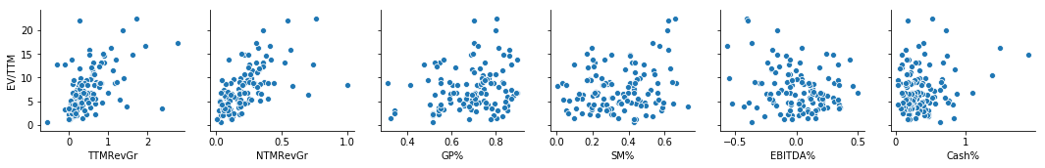
1. Executive Summary (1/1)
Data Exploration
Objective: To pre-emptively discover trends and anomalies in the dataset. The dataset contained 122 companies total with some initial outliers removed.
Dataset Features
Notable Observations
 | TTMRevGr | NTMRevGr | GP% | SM% | EBITDA% | Cash%
mean | 0.48 | 0.21 | 0.69 | 0.35 | 0.01 | 0.36
std | 0.50 | 0.17 | 0.13 | 0.17 | 0.22 | 0.29
min | -0.57 | 0.01 | 0.31 | 0.01 | -0.56 | 0.03
0.25 | 0.16 | 0.09 | 0.60 | 0.21 | -0.14 | 0.18
0.50 | 0.35 | 0.18 | 0.71 | 0.34 | 0.03 | 0.29
0.75 | 0.64 | 0.29 | 0.79 | 0.46 | 0.16 | 0.46
max | 2.77 | 1.00 | 0.90 | 0.73 | 0.50 | 1.88
Large Deviation in TTM Revenue Growth and NTM Revenue Growth: NTM revenue growth for all companies was set fairly conservatively, the difference between 1st and 3rd quartile being only 20%. Suggests either a dropoff in market expectations or conservatism in analyst estimates. This is in contrast to TTM revenue growth which has a 48% difference between the 1st and 3rd quartiles as well as a max growth rate of 277%.
Small Deviations in Gross Profit %: The first and third quartiles only differed by about 19% with the maximum value only 30% above the 1st quartile.
Variable Correlations
0.51
0.61
0.20
0.21
(0.21)
0.17

Slide 8
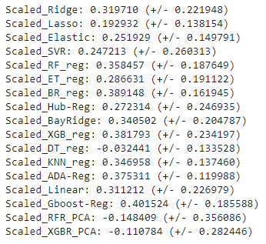
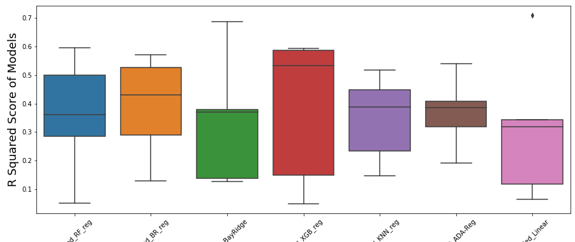
1. Executive Summary (1/1)
Model Exploration
Objective: To test various machine learning algorithms before selecting a subsection to use for modelling the dataset.
Model Methodology
Model Results (R Squared)
Uniform Scaling: Applied a scaling algorithm to the dataset to normalize mean at 0. Enabled various machine learning algorithms to be scored by the same metric.
Model Testing: Applied 17 regression algorithms to the dataset with normal parameters to cover a wide range of potential predictors.
Cross Validation: Applied 5 K-Fold cross validations per regression technique to obtain an average score for each technique and related min / max / standard deviation data.
Model Testing

Slide 9
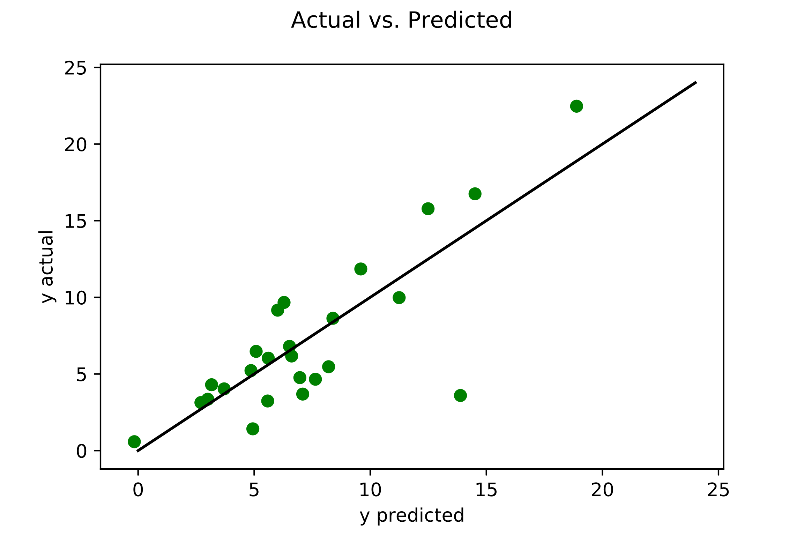
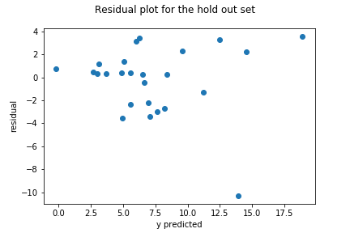
PROJECT TETRIS: Proposed Investment of up to USD40m into Databricks, an advanced big data processing company
Investment Committee Paper No: [ ]
Division: INVESTMENTS
Priority: HIGH
FOR APPROVAL
Linear Regression
A correlation test was first performed to determine the correlation between each independent variable and the EV/TTM Revenue multiple. A preliminary linear regression was then conducted to determine significant variables according to p-values (<0.05).
Model Training Concept
Model Features
Constant | (2.59)
Revenue Growth | 3.65
NTM Revenue Growth | 12.00
GP Margin | 8.62
S&M % of Revenue | -1.59
EBITDA % of Revenue | 1.09
Cash % of Revenue | 1.10
R Squared | 0.654 | Suggests that roughly 65% of the variability in EV/TTM can be explained by our variables.
Mean Squared Error | 2.954 | On average, the margin of error between the predicted values and the actual values.
Preliminary Results
Residual Plot
50% of test population predicted within + / - 2.
Source: Bloomberg

Slide 10
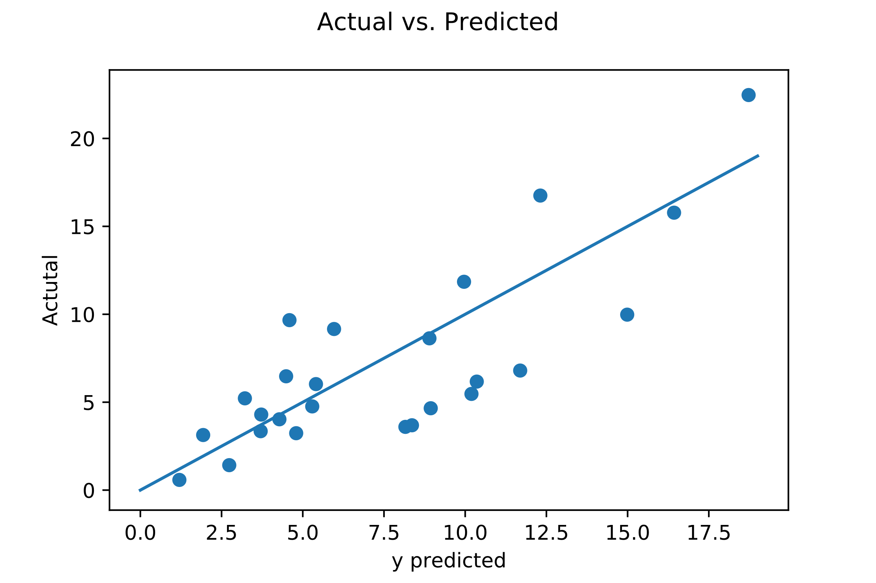
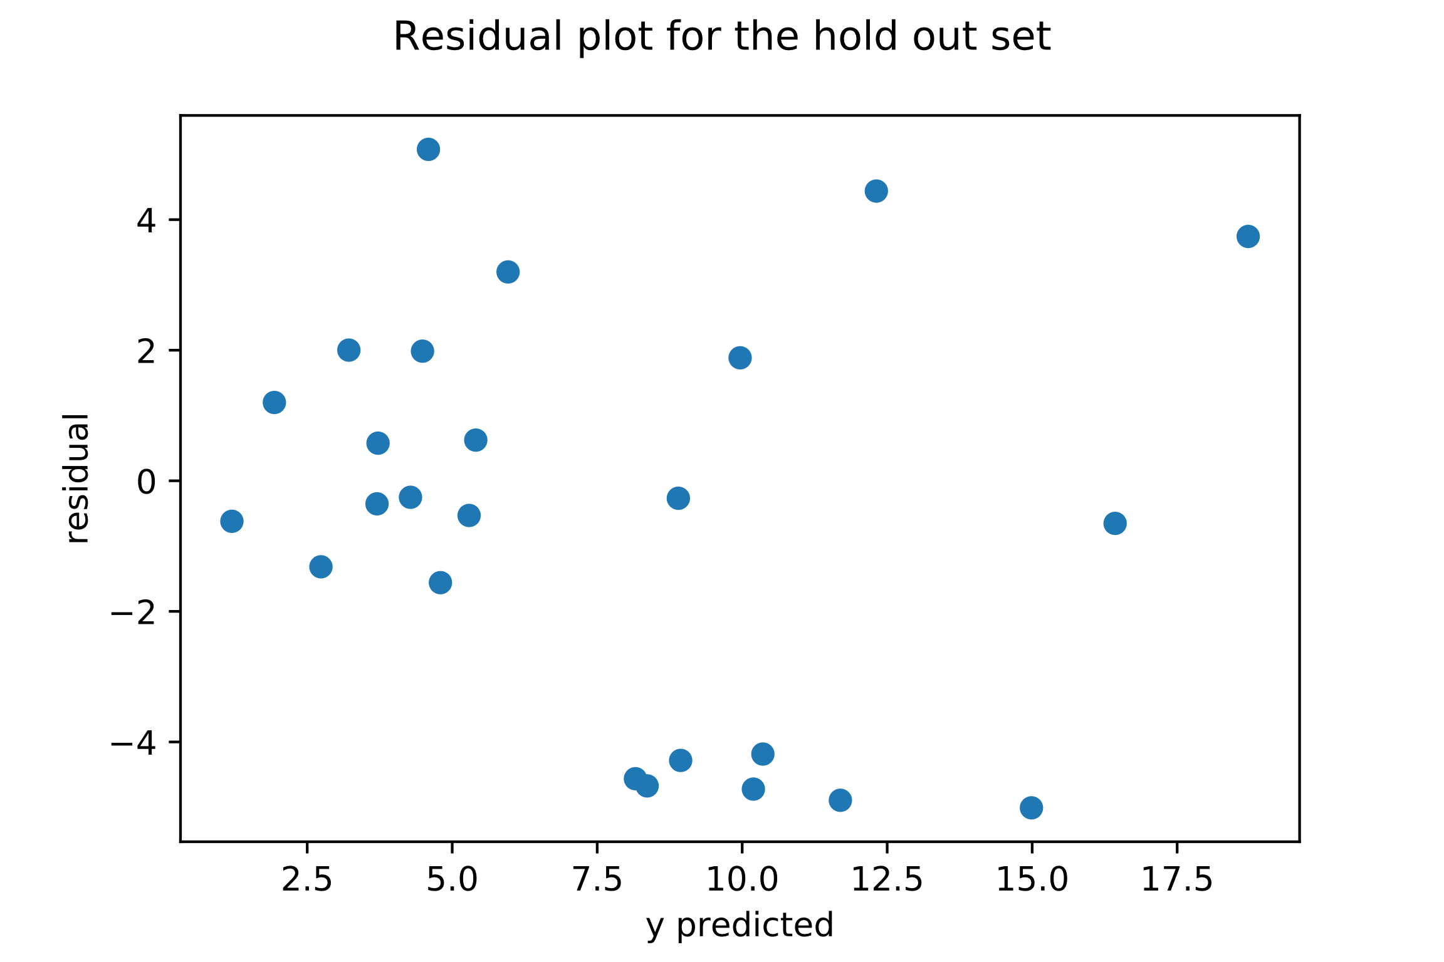
PROJECT TETRIS: Proposed Investment of up to USD40m into Databricks, an advanced big data processing company
Investment Committee Paper No: [ ]
Division: INVESTMENTS
Priority: HIGH
FOR APPROVAL
XGBoost Regression
A correlation test was first performed to determine the correlation between each independent variable and the EV/TTM Revenue multiple. A preliminary linear regression was then conducted to determine significant variables according to p-values (<0.05).
Model Features
Model Coefficients
Model Features
Model Training Concept
Strong Learner / Predictor
R Squared | 0.621 | Suggests that roughly 62% of the variability in EV/TTM can be explained by our variables.
Mean Squared Error | 3.090 | On average, the margin of error between the predicted values and the actual values.
Weak Learner / Predictor
In adaptive boosting, several iterations of the model are generated. Each iteration applies a weighting to the inputs from the previous iteration. Inputs that perform well receive a lower weight and vice versa. Weightings affect how often the input will be selected in future training iterations. This way, the model trains on more “outlier” inputs as training goes on, creating a model that can better predict outliers.
Preliminary Results
Residual Plot
56% of test population predicted within + / - 2.
Source: Bloomberg

Slide 11
PROJECT TETRIS: Proposed Investment of up to USD40m into Databricks, an advanced big data processing company
Investment Committee Paper No: [ ]
Division: INVESTMENTS
Priority: HIGH
FOR APPROVAL
4. Application to Khazanah Prospective Companies
By applying the training model to several of Khazanah’s former prospective companies, a rough comparison of the effectiveness of the two models was created. Both performed better than the other in half of the scenarios.
Examined Companies
Feature | Databricks | Velocloud | Crowdstrike | Mesosphere
TTM Revenue (USD’m) | 66.7 | 28.6 | 239.5 | 29.0
TTM Revenue Growth Rate | 124.7% | 273.4% | 107.2% | 168.5%
NTM Revenue Growth Rate | 95.2% | 101.3% | 91.4% | 67.0%
Gross Margin | 67.1% | 61.7% | 64.1% | 76.0%
S&M % of Revenue | 98.2% | 52.0% | 83.8% | 129.7%
EBITDA Margin | (114.9%) | (108.3%) | (77.4%) | (269.7%)
Cash % of Revenue | 188.9% | 104.2% | 147.2% | 193.1%
Feature Selection Methodology
Model Comparison
“TTM” Data fitted to the YE of the deal’s closing.
Projected numbers from management was used when available, otherwise team’s projections were used.
Post-Money Valuation (EV) from PitchBook was used when available, otherwise team’s projections were used.
Multiples | Actual | Linear | XGBoost
Databricks | 22.49* | 18.44 | 15.76
Velocloud | 11.19 | 24.01 | 15.72
Crowdstrike | 13.15 | 17.27 | 16.45
Mesosphere | 22.41 | 17.08 | 15.64
Valuation | Actual | Linear | XGBoost
Databricks | 1500* | 1230 | 1051
Velocloud | 320 | 687 | 450
Crowdstrike | 3150 | 4135 | 3746.65
Mesosphere | 650 | 495 | 477
Source: Company Website and Provided Data

Slide 12
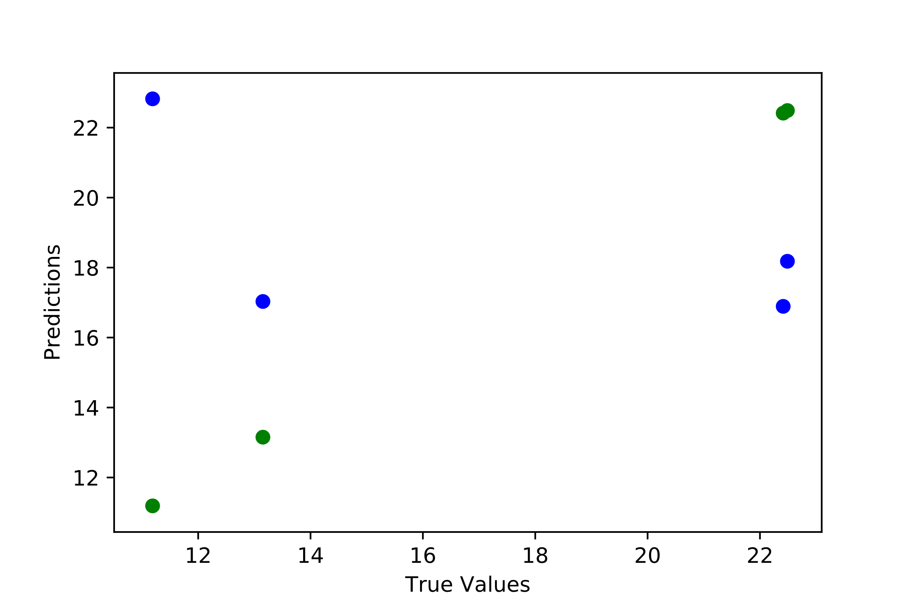
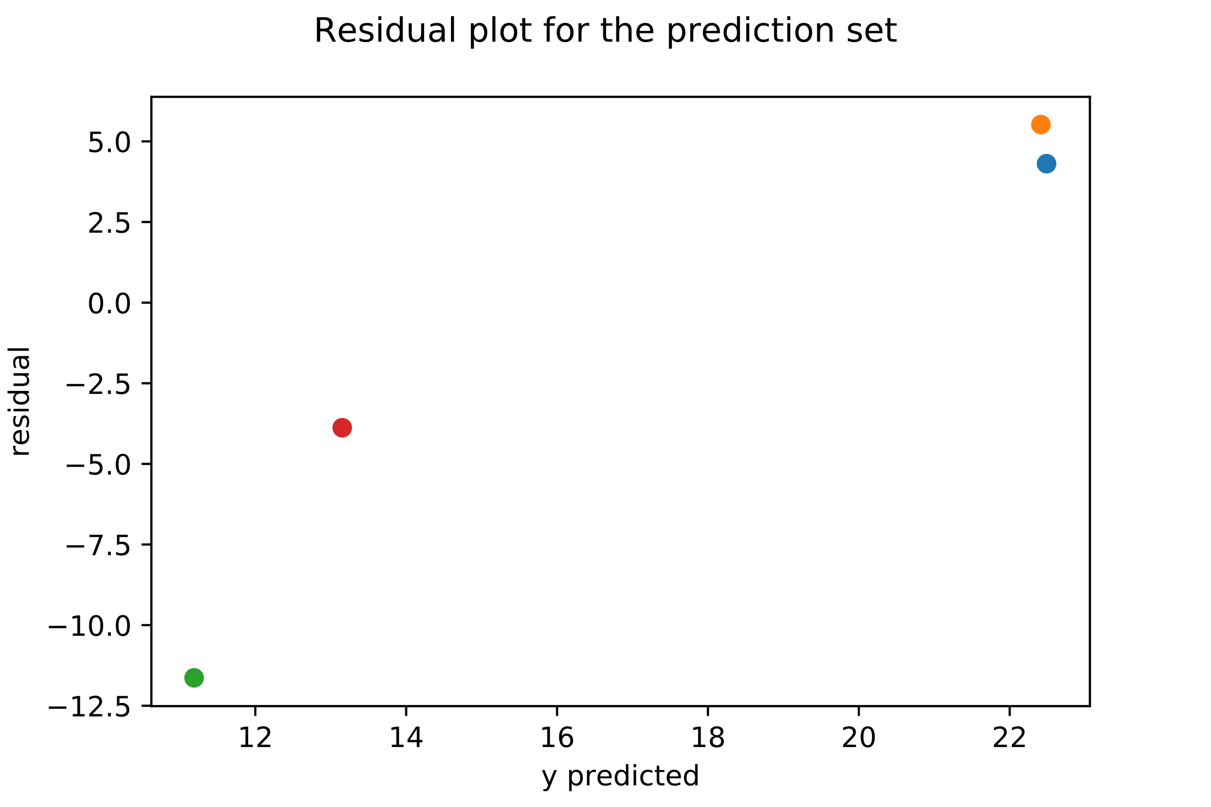
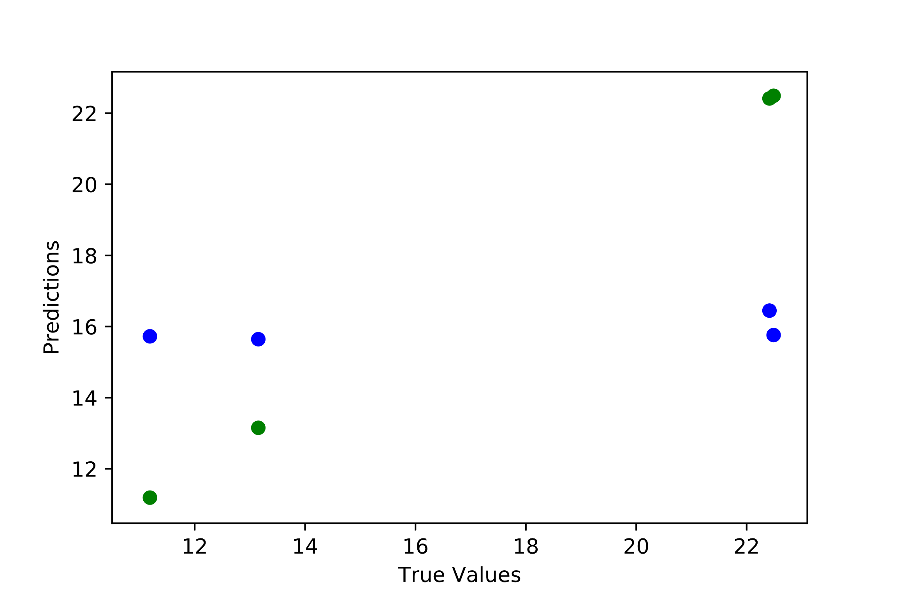
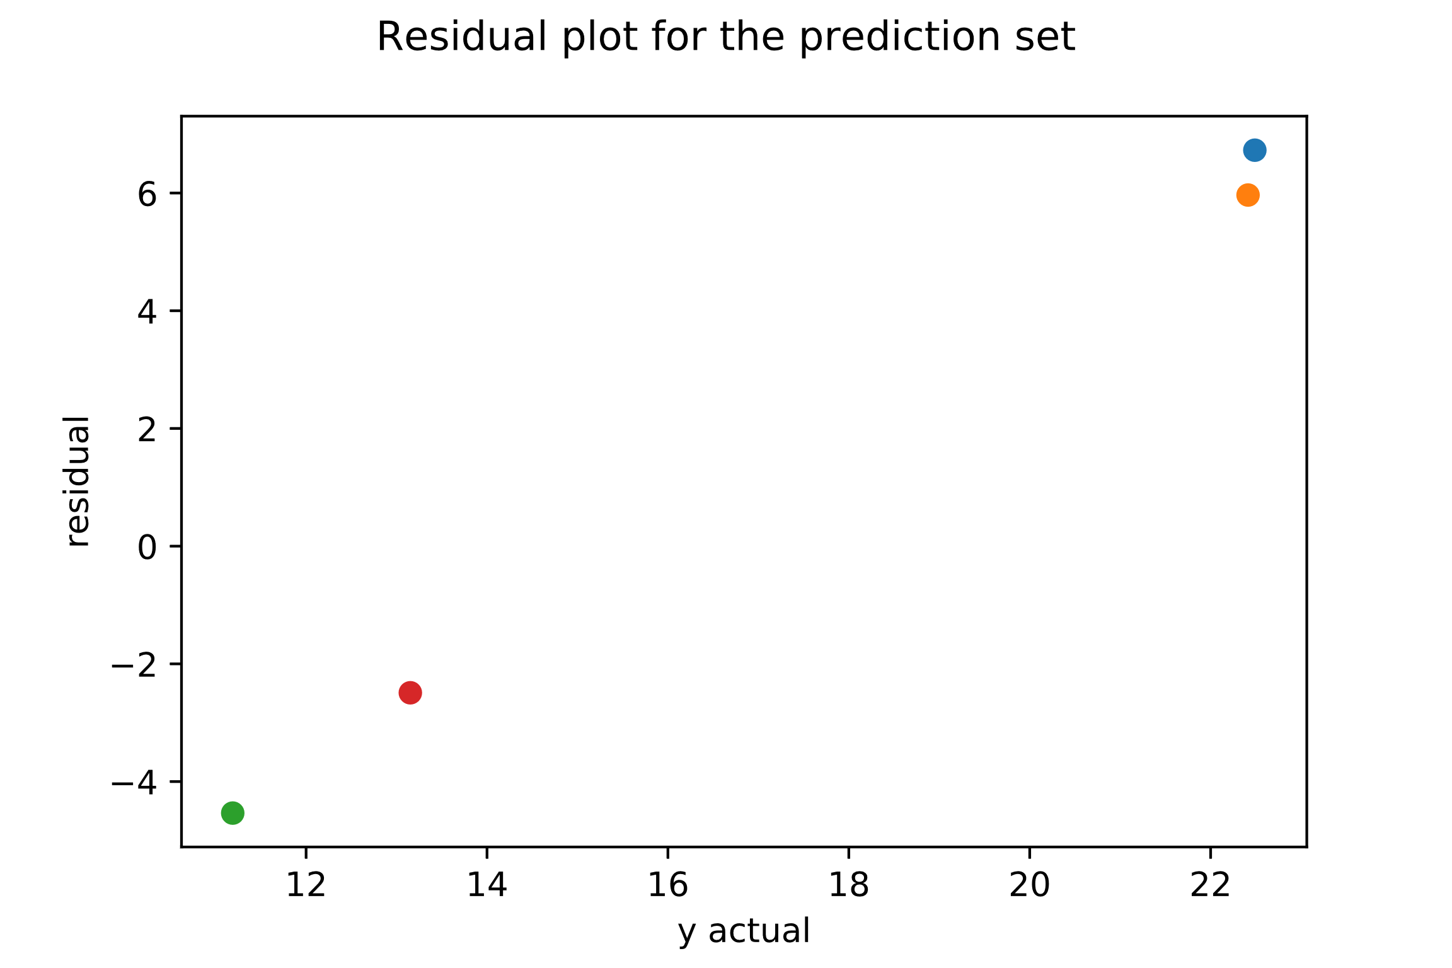
PROJECT TETRIS: Proposed Investment of up to USD40m into Databricks, an advanced big data processing company
Investment Committee Paper No: [ ]
Division: INVESTMENTS
Priority: HIGH
FOR APPROVAL
Regression Model Results vs. Actual Values
Regression Model Results vs. Actual Values
Velocloud
Mesosphere
Databricks
Crowdstrike
Databricks
Mesosphere
Crowdstrike
Predicted
Actual
Velocloud
Regression Model Results vs. Actual Values
Regression Model Results vs. Actual Values
Databricks
Mesosphere
Crowdstrike
Databricks
Mesosphere
Crowdstrike
Predicted
Velocloud
Actual
Velocloud
Source: Company Website and Provided Data

Slide 13
1. Executive Summary (1/1)
Feature Selection
Objective: To determine the relevant features that contribute to a company’s EV/TTM multiple and use those features for subsequent modelling.
Data Collection Methodology
Feature Ranking Methodology
EV: To mitigate against random EV changes due to overall stock market movements, the average EV from the TTM was used as each company’s measurement EV.
Historical Data: All data was pulled from Bloomberg using the related TTM function.
NTM Data: Future data was pulled from Bloomberg and is represented as an amalgamation of analyst estimates and not guaranteed to be a reflection of the company’s true performance or market sentiment.
Balance Sheet Figures: Latest company reported figures, not relative to any yearly average.
Stability Selection: Algorithm that injects noise into the original dataset and uses the lasso regression method to rank the important of features in the dataset.
Recursive Feature Elimination: Used linear regression to iterate through dataset and rank features by best to worst performing.
Linear Model Feature Ranking: Applied three linear models (Linear, Ridge, Lasso) to determine relative coefficients and rankings.
Random Forest Feature Ranking: Utilized random forest’s feature importance method to build another feature ranking.
Feature Matrix: Created mean ranking for each feature based on above rankings and outputted them into a graph.
Screening Variables (TTM unless otherwise specified)
Feature Ranking Matrix
 | Dollars | Percentages
Dependent Variable | EV/TTM Revenue Multiple | N/A
Revenue Items | 2TY Revenue Revenue NTM Revenue Gross Profit | Revenue Growth Rate (%) NTM Revenue Growth Rate (%) Gross Margin (%)
Expense Items | R&D Expense S&M Expense G&A Expense EBITDA Net Income | R&D % of Revenue (%) S&M % of Revenue (%) G&A % of Revenue (%) EBITDA Margin (%) Profit Margin (%)
Other Items | Free Cash Flow Cash | FCF % of Revenue (%) Cash % of Revenue (%)
*Selected features > 0.2
Note: (1) Listed in North America, Subsectors “Application Software” + “Data Processing” + “Systems Software”
Source: Bloomberg

Slide 14
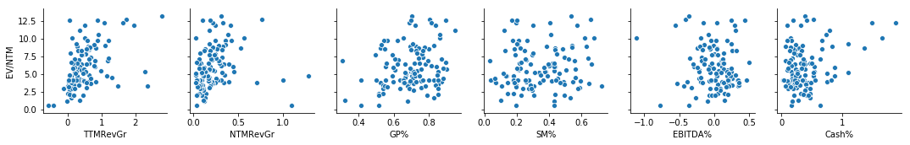
1. Executive Summary (1/1)
Data Exploration
Objective: To pre-emptively discover trends and anomalies in the dataset. The dataset contained 122 companies total with some initial outliers removed.
Dataset Features
Notable Observations
 | TTMRevGr | NTMRevGr | GP% | SM% | EBITDA% | Cash%
mean | 0.48 | 0.21 | 0.69 | 0.35 | 0.01 | 0.36
std | 0.50 | 0.17 | 0.13 | 0.17 | 0.22 | 0.29
min | -0.57 | 0.01 | 0.31 | 0.01 | -0.56 | 0.03
0.25 | 0.16 | 0.09 | 0.60 | 0.21 | -0.14 | 0.18
0.50 | 0.35 | 0.18 | 0.71 | 0.34 | 0.03 | 0.29
0.75 | 0.64 | 0.29 | 0.79 | 0.46 | 0.16 | 0.46
max | 2.77 | 1.00 | 0.90 | 0.73 | 0.50 | 1.88
Large Deviation in TTM Revenue Growth and NTM Revenue Growth: NTM revenue growth for all companies was set fairly conservatively, the difference between 1st and 3rd quartile being only 20%. Suggests either a dropoff in market expectations or conservatism in analyst estimates. This is in contrast to TTM revenue growth which has a 48% difference between the 1st and 3rd quartiles as well as a max growth rate of 277%.
Small Deviations in Gross Profit %: The first and third quartiles only differed by about 19% with the maximum value only 30% above the 1st quartile.
Variable Correlations
0. 47
0.20
0.24
0.11
(0.10)
0.29

Slide 15
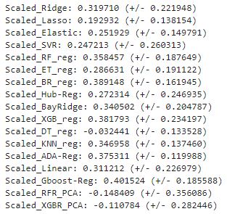
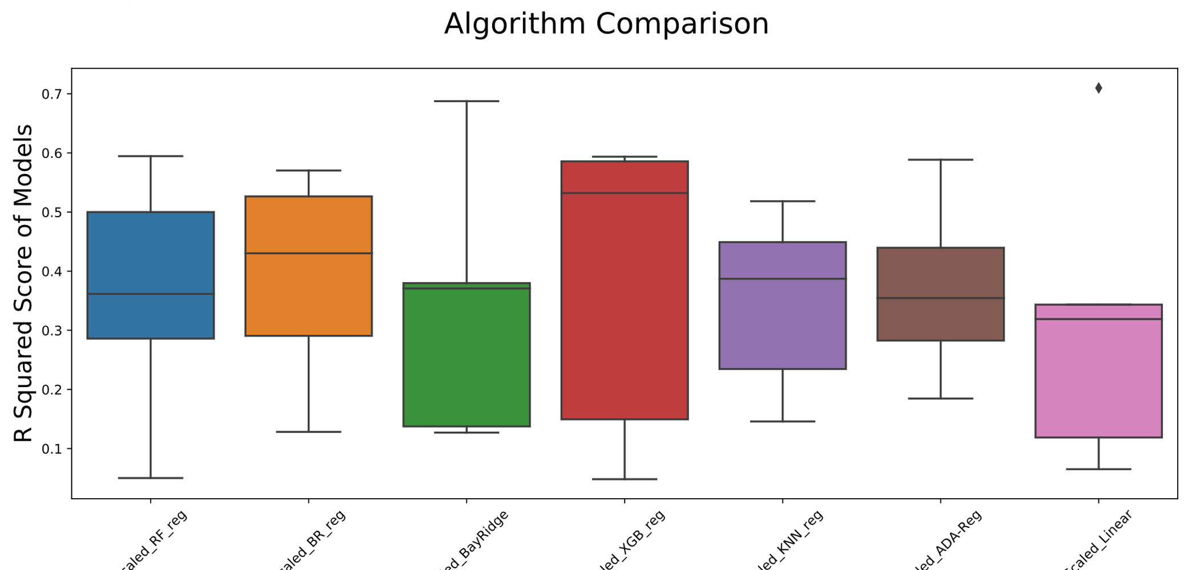
1. Executive Summary (1/1)
Model Exploration
Objective: To test various machine learning algorithms before selecting a subsection to use for modelling the dataset.
Model Methodology
Model Results (R Squared)
Uniform Scaling: Applied a scaling algorithm to the dataset to normalize mean at 0. Enabled various machine learning algorithms to be scored by the same metric.
Model Testing: Applied 17 regression algorithms to the dataset with normal parameters to cover a wide range of potential predictors.
Cross Validation: Applied 5 K-Fold cross validations per regression technique to obtain an average score for each technique and related min / max / standard deviation data.
Model Testing

Slide 16
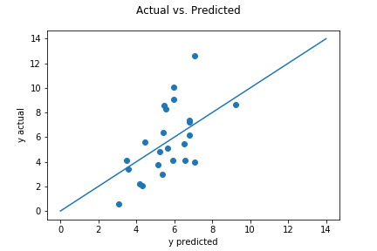
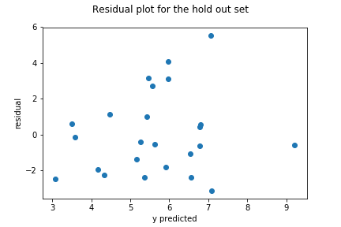
PROJECT TETRIS: Proposed Investment of up to USD40m into Databricks, an advanced big data processing company
Investment Committee Paper No: [ ]
Division: INVESTMENTS
Priority: HIGH
FOR APPROVAL
Linear Regression
A correlation test was first performed to determine the correlation between each independent variable and the EV/TTM Revenue multiple. A preliminary linear regression was then conducted to determine significant variables according to p-values (<0.05).
Model Training Concept
Model Features
Constant | 0.34
Revenue Growth | 2.24
NTM Revenue Growth | 0.64
GP Margin | 7.02
S&M % of Revenue | -4.26
EBITDA % of Revenue | -1.97
Cash % of Revenue | 2.32
R Squared | 0.351 | Suggests that roughly 35% of the variability in EV/TTM can be explained by our variables.
Mean Squared Error | 2.252 | On average, the margin of error between the predicted values and the actual values.
Preliminary Results
Residual Plot
60% of test population predicted within + / - 2.
Source: Bloomberg

Slide 17
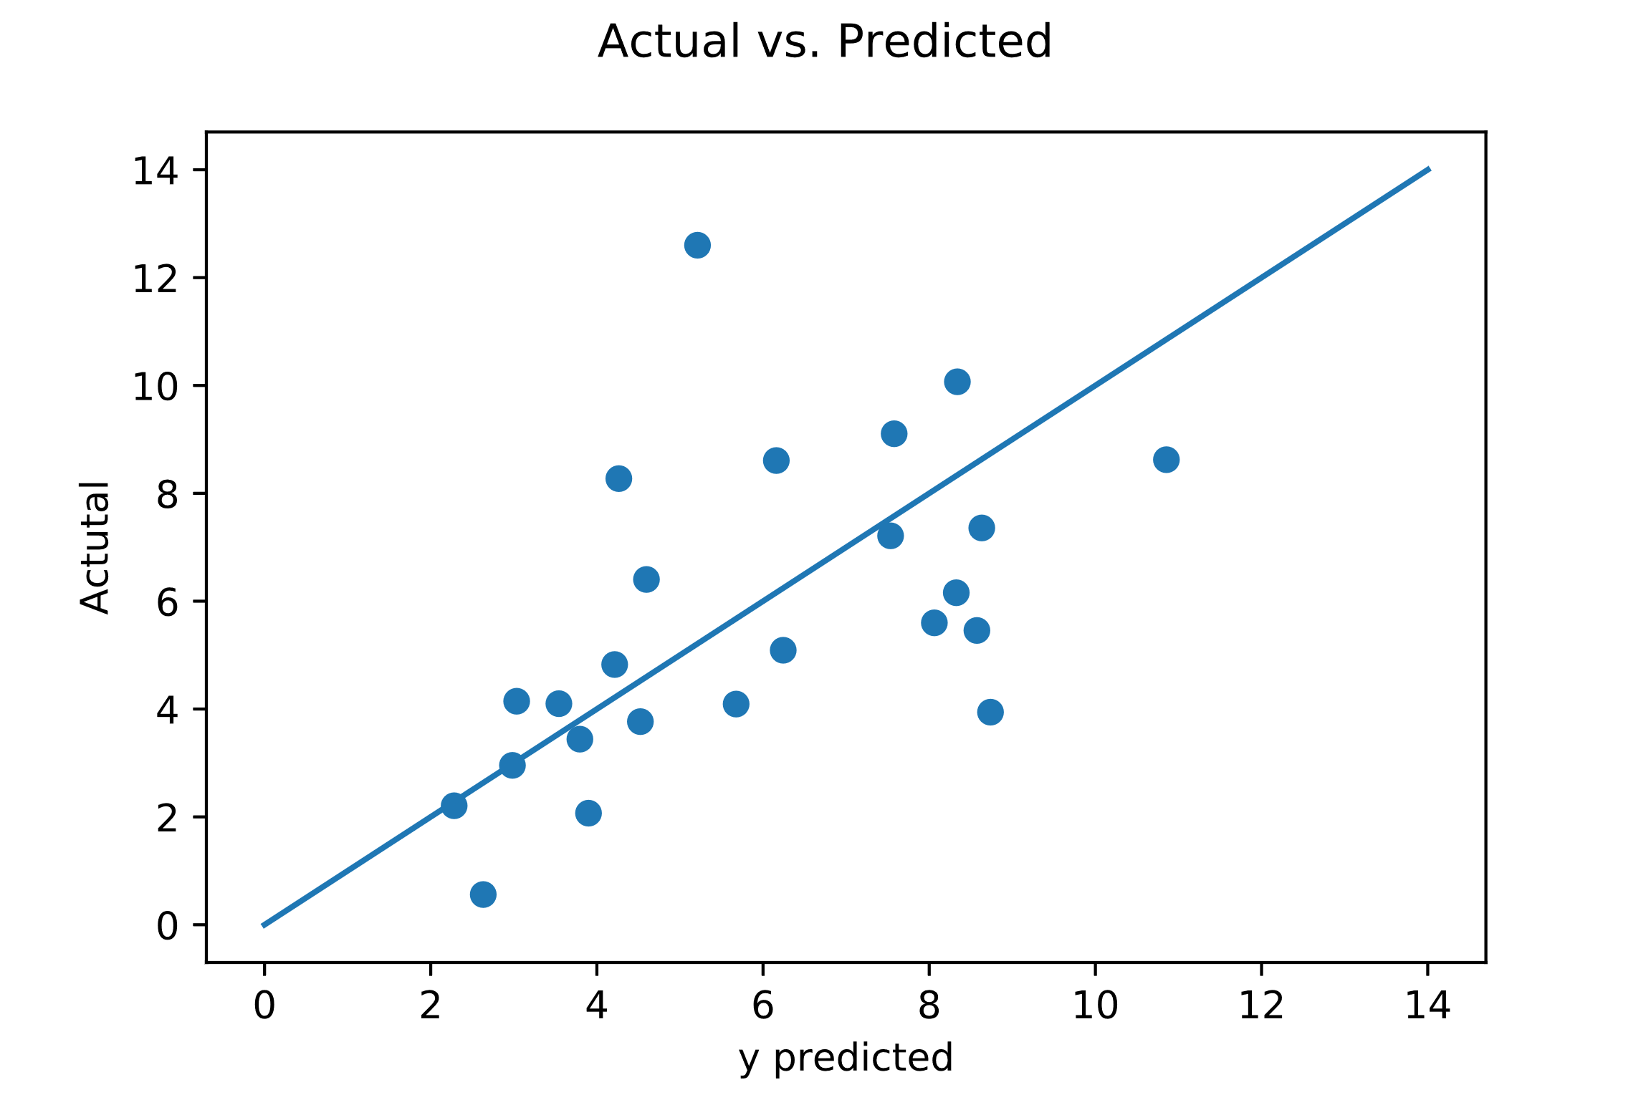
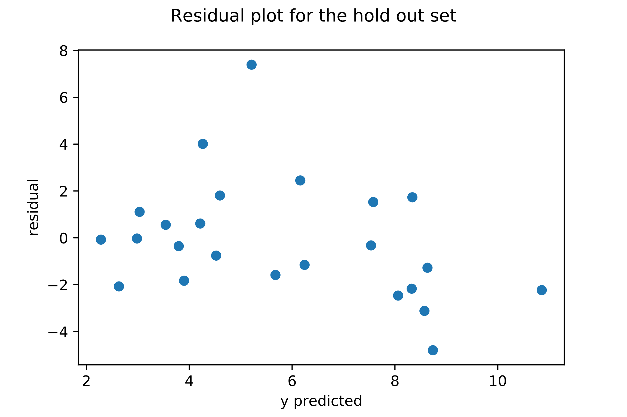
PROJECT TETRIS: Proposed Investment of up to USD40m into Databricks, an advanced big data processing company
Investment Committee Paper No: [ ]
Division: INVESTMENTS
Priority: HIGH
FOR APPROVAL
XGBoost Regression
A correlation test was first performed to determine the correlation between each independent variable and the EV/TTM Revenue multiple. A preliminary linear regression was then conducted to determine significant variables according to p-values (<0.05).
Model Features
Model Coefficients
Model Features
Model Training Concept
Strong Learner / Predictor
R Squared | 0.203 | Suggests that roughly 20% of the variability in EV/TTM can be explained by our variables.
Mean Squared Error | 2.496 | On average, the margin of error between the predicted values and the actual values.
Weak Learner / Predictor
In adaptive boosting, several iterations of the model are generated. Each iteration applies a weighting to the inputs from the previous iteration. Inputs that perform well receive a lower weight and vice versa. Weightings affect how often the input will be selected in future training iterations. This way, the model trains on more “outlier” inputs as training goes on, creating a model that can better predict outliers.
Preliminary Results
Residual Plot
76% of test population predicted within + / - 2.
Source: Bloomberg

Slide 18
PROJECT TETRIS: Proposed Investment of up to USD40m into Databricks, an advanced big data processing company
Investment Committee Paper No: [ ]
Division: INVESTMENTS
Priority: HIGH
FOR APPROVAL
4. Application to Khazanah Prospective Companies
By applying the training model to several of Khazanah’s former prospective companies, a rough comparison of the effectiveness of the two models was created. Both performed better than the other in half of the scenarios.
Examined Companies
Feature | Databricks | Velocloud | Crowdstrike | Mesosphere
NTM Revenue (USD’m) | 130.1 | 46.8 | 458.4 | 48.4
TTM Revenue Growth Rate | 124.7% | 273.4% | 107.2% | 168.5%
NTM Revenue Growth Rate | 95.2% | 101.3% | 91.4% | 67.0%
Gross Margin | 67.1% | 61.7% | 64.1% | 76.0%
EBITDA Margin | (114.9%) | (108.3%) | (77.4%) | (269.7%)
Cash % of Revenue | 188.9% | 104.2% | 147.2% | 193.1%
S&M % of Revenue | 98.2% | 52.0% | 83.8% | 129.7%
Feature Selection Methodology
Model Comparison
“TTM” Data fitted to the YE of the deal’s closing.
Projected numbers from management was used when available, otherwise team’s projections were used.
Post-Money Valuation (EV) from PitchBook was used when available, otherwise team’s projections were used.
Multiples | Actual | Linear | XGBoost
Databricks | 11.53* | 10.92 | 11.14
Velocloud | 6.84 | 13.77 | 12.91
Crowdstrike | 6.87 | 9.19 | 11.27
Mesosphere | 13.43 | 17.93 | 13.56
Valuation | Actual | Linear | XGBoost
Databricks | 1500* | 1421 | 1449
Velocloud | 320 | 647 | 604
Crowdstrike | 3150 | 4213 | 5166
Mesosphere | 650 | 868 | 656
Source: Company Website and Provided Data

Slide 19
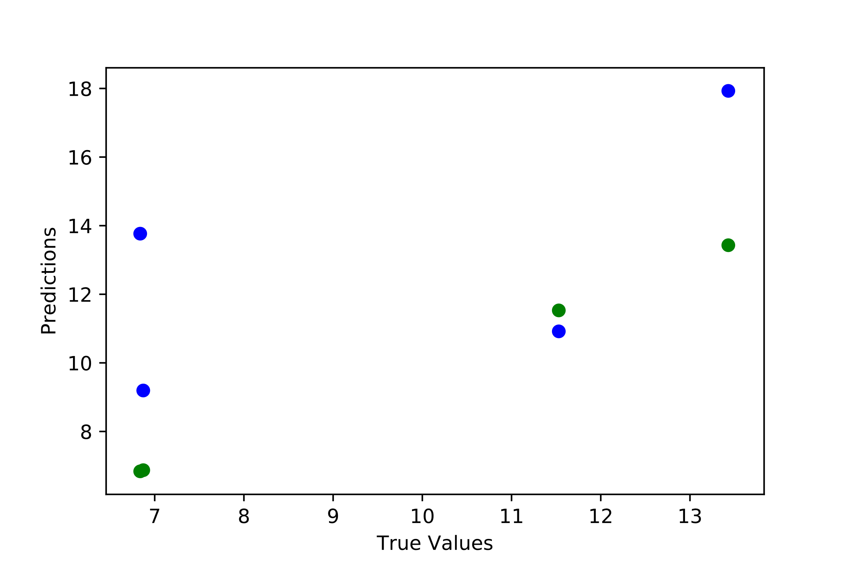
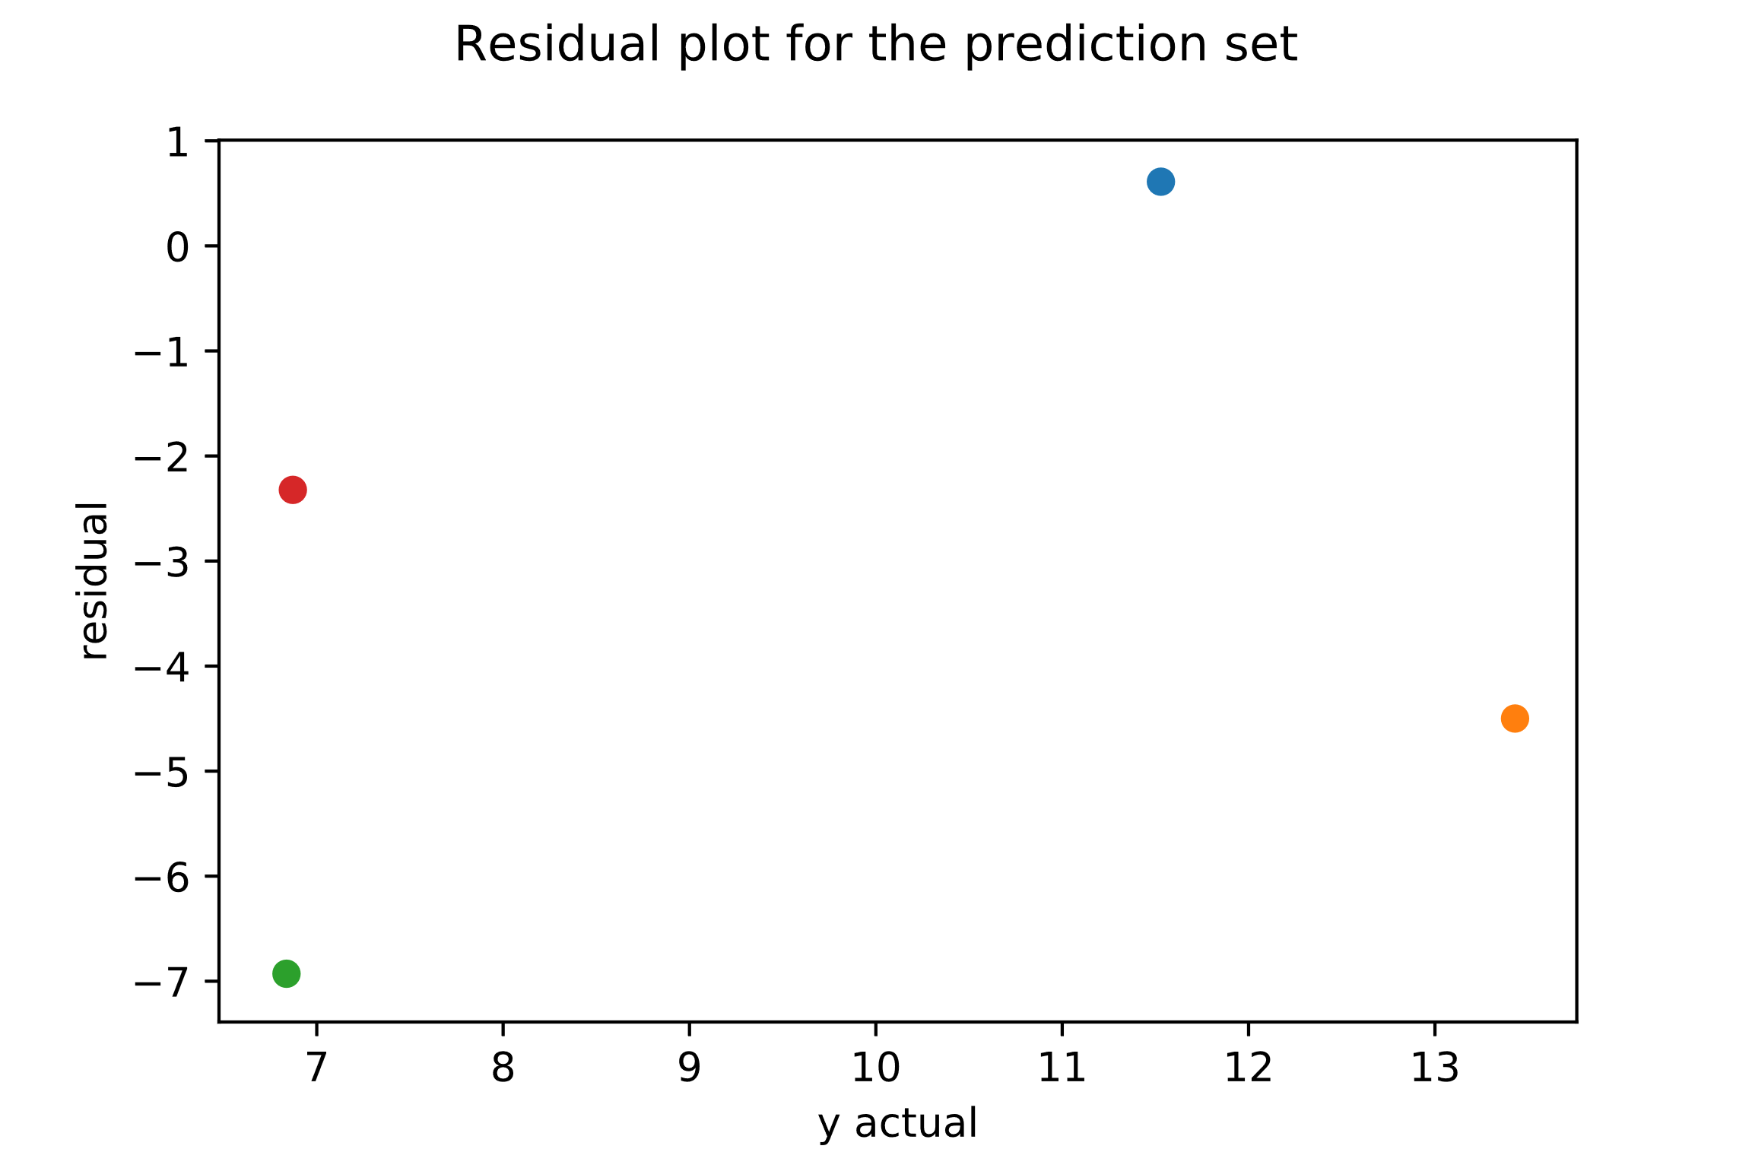
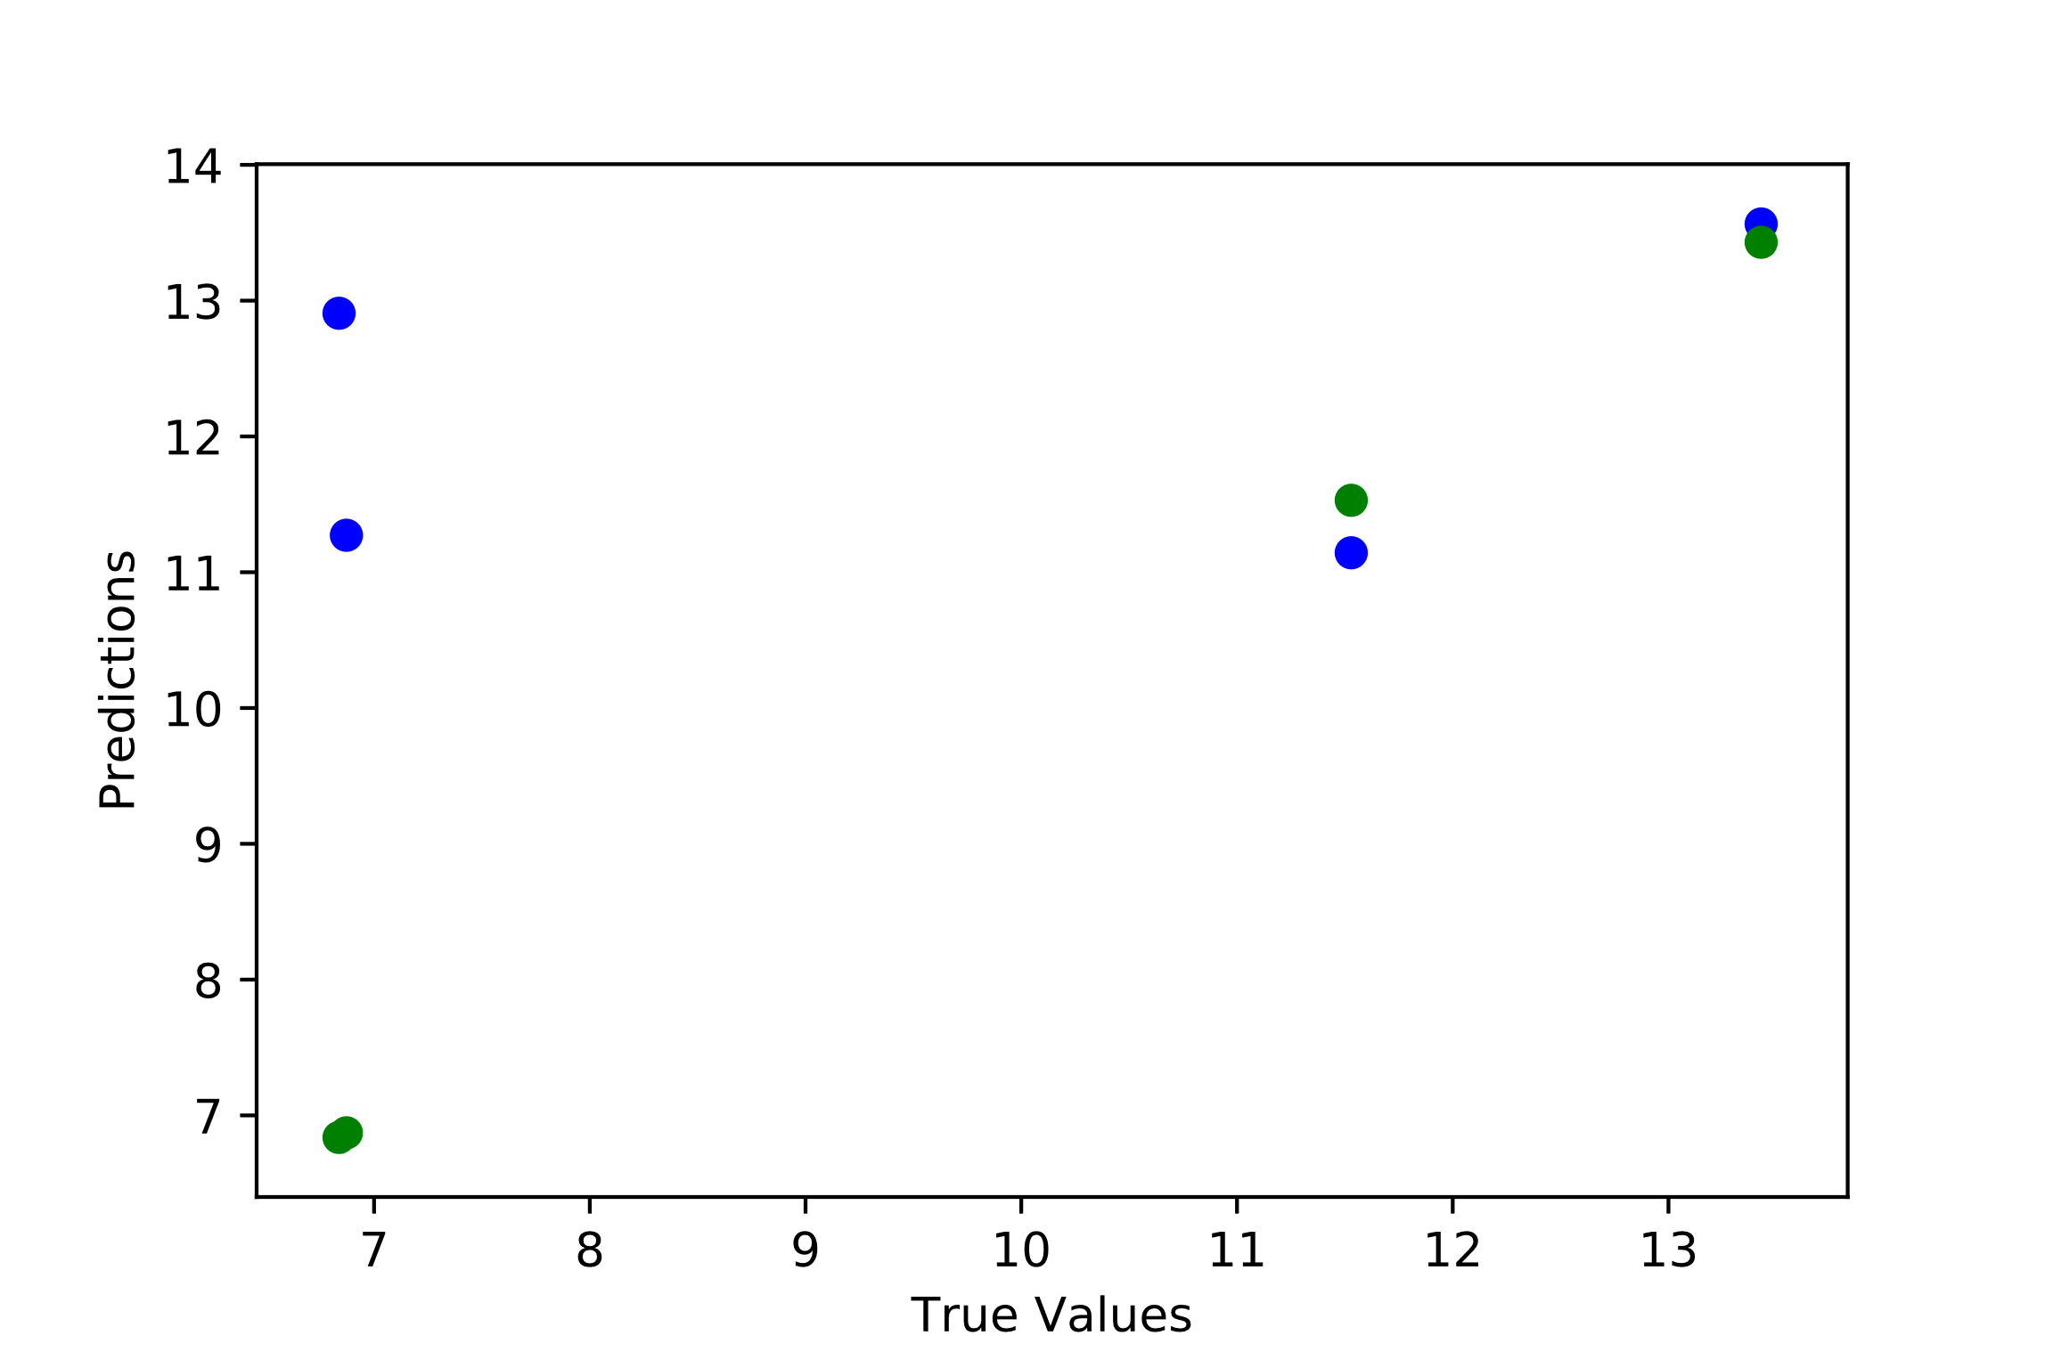
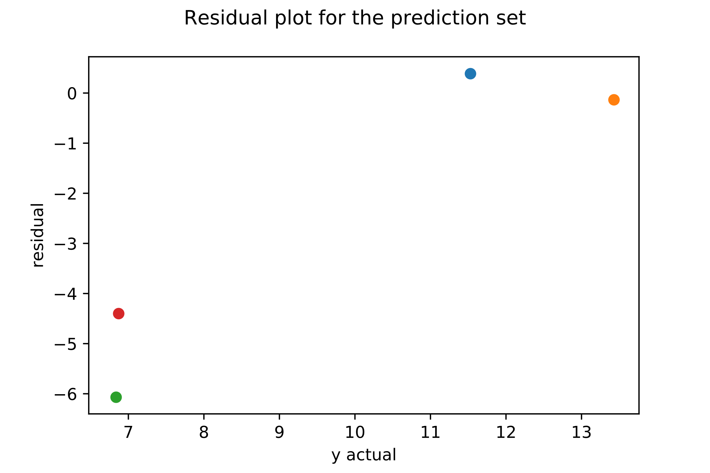
PROJECT TETRIS: Proposed Investment of up to USD40m into Databricks, an advanced big data processing company
Investment Committee Paper No: [ ]
Division: INVESTMENTS
Priority: HIGH
FOR APPROVAL
Regression Model Results vs. Actual Values
Regression Model Results vs. Actual Values
Mesosphere
Databricks
Velocloud
Crowdstrike
Databricks
Crowdstrike
Mesosphere
Predicted
Actual
Velocloud
Regression Model Results vs. Actual Values
Regression Model Results vs. Actual Values
Mesosphere
Mesosphere
Crowdstrike
Databricks
Velocloud
Databricks
Velocloud
Predicted
Crowdstrike
Actual
Source: Company Website and Provided Data

Slide 20
PROJECT TETRIS: Proposed Investment of up to USD40m into Databricks, an advanced big data processing company
Investment Committee Paper No: [ ]
Division: INVESTMENTS
Priority: HIGH
FOR APPROVAL
 | Risks | Potential Mitigation
Quality and Size of Dataset | The revenue growth rate retrieved from Bloomberg is based off of analyst projections that are not guaranteed to be accurate. A portion of the data retrieved was also incomplete (missing one or more of analyzed variables), and incomplete datasets were removed from the analysis, potentially skewing or biasing the companies analyzed. Additionally, many companies added cannot be considered direct competitors or comparison companies to Databricks, the overall pool should be carefully re-examined and refreshed for future analysis. | Add additional companies Add and test additional features, potentially look into categorical or qualitative features like strength of management, positioning amongst competitors etc. Segment the population further by age / stage in growth to capture a more comparable peer group Consider utilizing a pool of strictly private company data. This could potentially be pulled from company S-1s prior to IPO. However, the trade-off lies in the loss of any time-value, as each company’s IPO date and surrounding market conditions will be completely different.
Modelling | The model may be overfitting and not truly perform as well as it appears simply due to the low sample size in the given data. While 5x cross-validation was used in this study, when increased to 10x (the industry average), the deviation in r squared values rose significantly, likely due to the small test sets (~25 companies). The models were not adequately hypertuned and that presents an opportunity going forward. | Add additional companies Consider imputation techniques to address the problem encountered with missing data to expand the dataset Consider modelling for EV/NTM again with the new features and seeing if there’s an improvement
Difficulty Extrapolating | While both models performed well against a set of test companies from public markets, both models had problems extrapolating to companies like Databricks, Velocloud, Crowdstrike, and Mesosphere. | Create new datasets with more approximate comparable companies. Add additional relevant features to improve model performance.

Slide 21
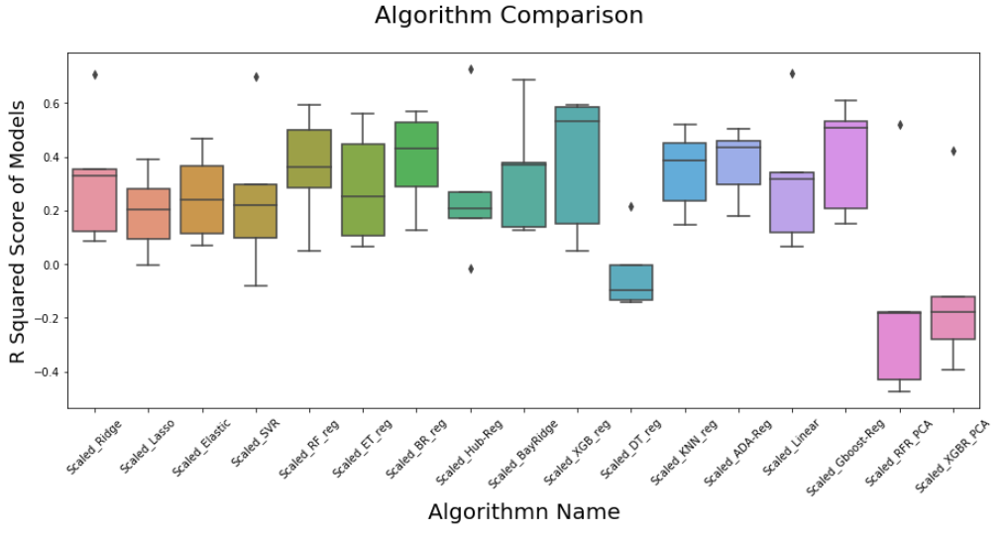

Slide 22
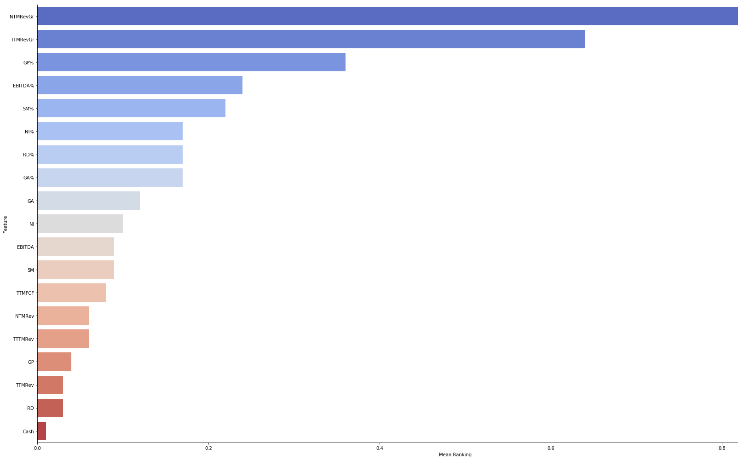

Slide 23
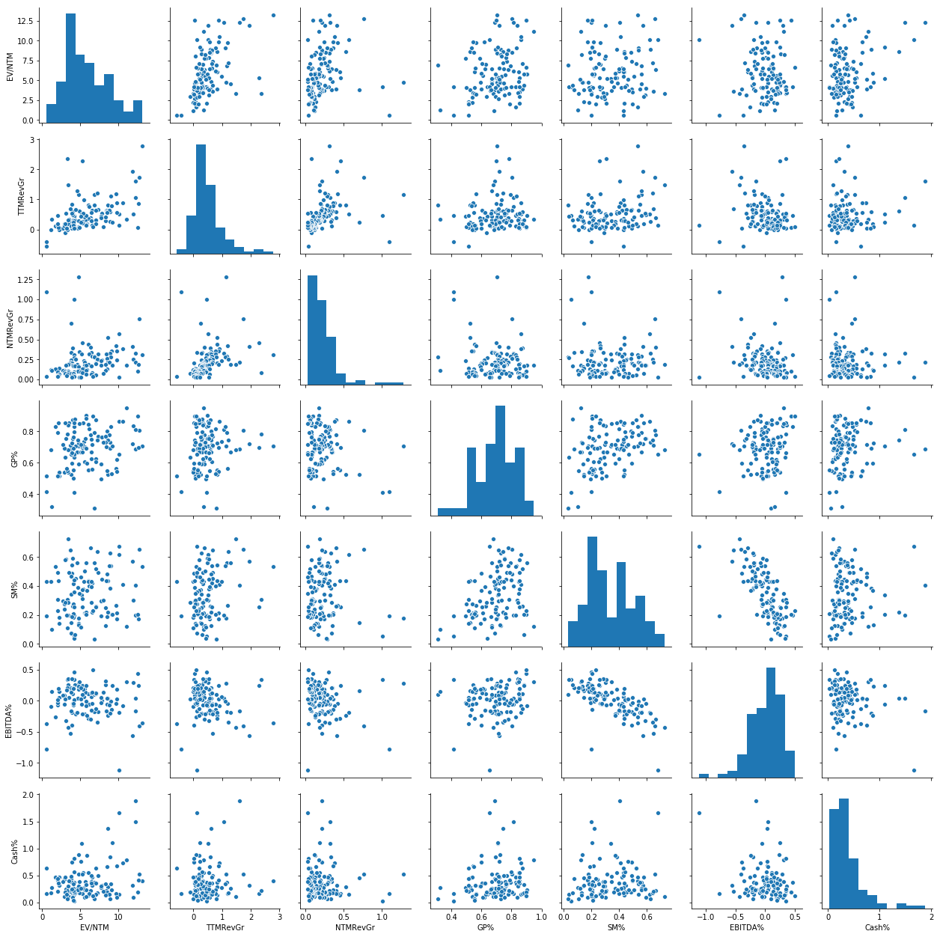

Slide 24
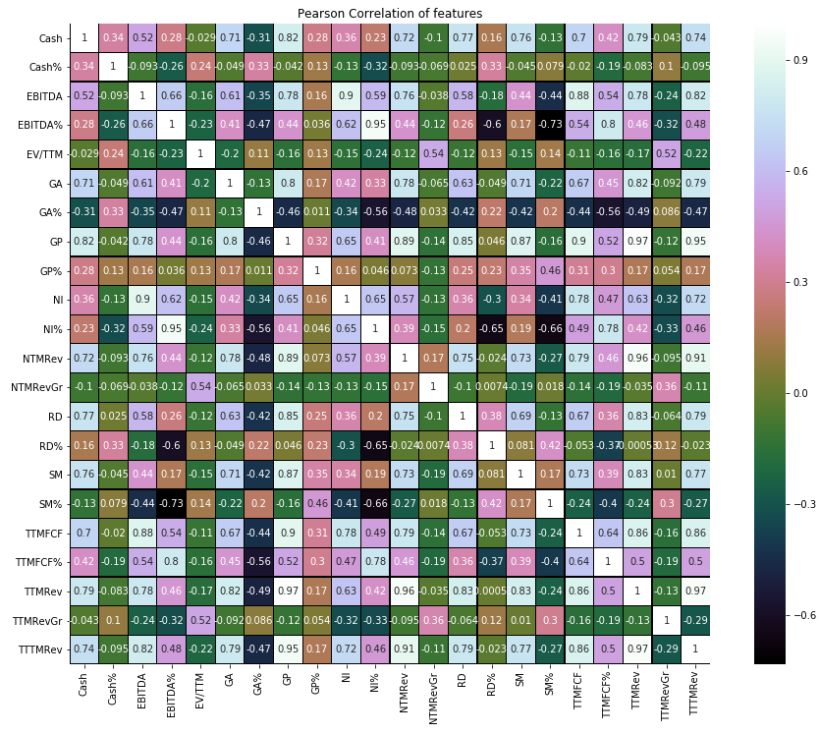

Slide 25
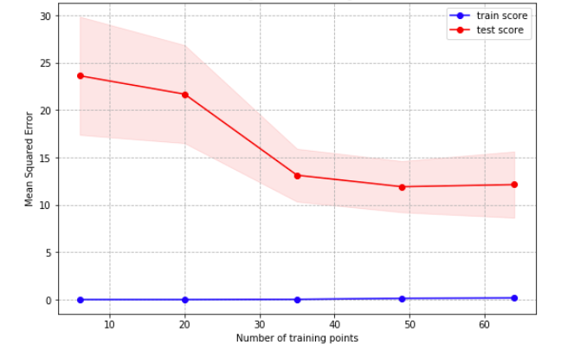
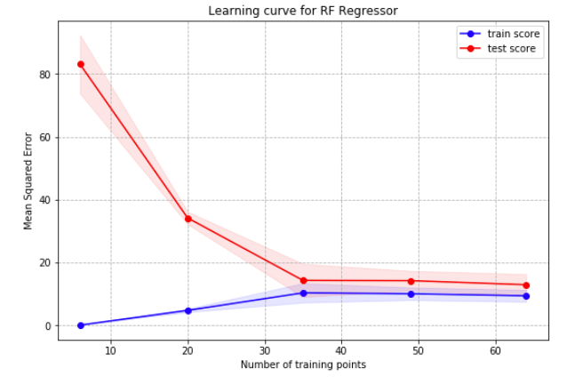
PROJECT TETRIS: Proposed Investment of up to USD40m into Databricks, an advanced big data processing company
Investment Committee Paper No: [ ]
Division: INVESTMENTS
Priority: HIGH
FOR APPROVAL
Model Features
Model Coefficients
Linear
XGBoost

